Slide 1
IBM Cloud Private Storage

Slide 2
Persistence and Kubernetes
IBM Cloud Private and storage
Making your storage decision

Slide 3
Kubernetes Persistent Storage
PV, PVC, Storage Class and Beyond

Slide 4
Persistent Storage Overview
Storage that persists beyond the lifecycle of the container allows workload to achieve state
Docker, containers and persistence
Kubernetes, pods and persistence
Terminology and the persistent lexicon
Value of the persistence solution
4
IBM Cloud / © 2018 IBM Corporation

Slide 5
It is about STATE not STORAGE
We strive to simplify our configuration management by moving towards immutability
Containers
Stateless
State
Pervasive
Containers are purposefully not Virtual Machines and do not carry the burden of a VMs resource management
Applications that containerize the best tend to be stateless with a small number of configuration parameters required for personalization
Some services require backing storage to maintain the current operating state such as a database or an applications that persist transactions
As orchestration is used to place containerized workload throughout the private cloud it becomes important that the persistent storage is equally mobile
5
IBM Cloud / © 2018 IBM Corporation
Notes:
Out of the Box, Two repositories are included:
IBM Charts – Publicly available, hosted on github.com/ibm/charts
Local Charts – Installed with IBM Cloud Private

Slide 6
Docker and Storage
Backends
The backend you chose (or that is chosen for you) depends heavily on the architecture of your nodes and version of Docker
Understand your backend when troubleshooting
Pay attention to backing filesystems
overlay2
Built upon the original AUFS
This is likely the first choice if available for your Linux distribution
Device Mapper
May be preferred for CentOS (and derivatives)
https://success.docker.com/article/compatibility-matrix
The storage backend in Docker handles reads and writes and supports key features such as layering
IBM Cloud / © 2018 IBM Corporation

Slide 7
Methods for persisting data
There are different methods for persisting data for a workload
Configuration and settings can be persisted using Config Maps and Secrets
Data can be stored using another cloud service hosted either in the private cloud or elsewhere in the enterprise (this then becomes a stateless workload)
A Persistent Volume Claim make a dynamic request for storage via a previously defined Storage Class that supports a specific storage provider and set of use cases
A Persistent Volume Claim can be made by the developer against a Persistent Volume that a storage administrator has previously created
7
IBM Cloud / © 2018 IBM Corporation
Notes:
Out of the Box, Two repositories are included:
IBM Charts – Publicly available, hosted on github.com/ibm/charts
Local Charts – Installed with IBM Cloud Private

Slide 8
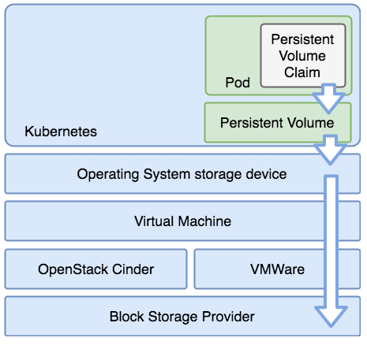
Persistent Storage
Persistent Volume is a storage resource within the cluster. PVs have a lifecycle independent of any individual pod that uses it. This API object encapsulates the details of the storage implementation or cloud-provider-specific storage system.
A Persistent Volume Claim is a storage request, or claim, made by the developer. Claims request specific sizes of storage, as well as other aspects such as access modes.
A StorageClass describes an offering of storage and allow for the dynamically provisioning of PVs and PVCs based upon these controlled definitions.
8
IBM Cloud / © 2018 IBM Corporation

Slide 9
Volume and Claim Lifecycle
The Reclaim policy informs the cluster what to do with the volume after it has been released from its claim
Retain allows for the manual reclamation of the storage asset. The PVC is deleted but the PV remains.
Delete reclaim policy removes both the objects from within the cluster, as well as the associated storage asset from the external infrastructure.
Recycle has been depricated and should no longer be used.
Access Modes define how volumes can be mounted in the manner supported by the storage provider
ReadWriteOnce (RWO) can be mounted as read-write by a single node and pod
ReadOnlyMany (ROX) can be mounted read-only by many nodes and pods
ReadWriteMany (RWX) can be mounted as read-write by many nodes and pods
NOTE: Reclaim policy and Access Modes may be defined differently by each storage provider implementation.

Slide 10
Storage Class Example
Claiming ‘gold’ storage when deploying an app
Dynamic Provisioning Storage classes can map to a “provisioner” to dynamically provision persistent volumes based on the volume claim requests coming in as users deploy workloads and services.
Map to Storage Some storage providers support the dynamic provisioning and abstract details so the developer doesn’t need to take multiple steps to acquire, bind, and claim storage for their services.
Default Storage Class A default storage class can dynamically provision storage when a storage class is not specified.
apiVersion: v1
kind: PersistentVolumeClaim
metadata:
name: mypvc
namespace: testns
spec:
accessModes:
- ReadWriteOnce
resources:
requests:
storage: 100Gi
storageClassName: gold
Create ‘gold’ storage class, mapped to glusterfs
kind: StorageClass
apiVersion: storage.k8s.io/v1
metadata:
name: gold
provisioner: kubernetes.io/glusterfs
parameters:
resturl: “http://glusterIP:8080”
Change default storage class to GlusterFS
#get the names, see which is default
kubectl get storageclass
#set current default to “false”
kubectl patch storageclass default-class-name -p '{"metadata": {"annotations":{"storageclass.kubernetes.io/is-default-class":"false"}}}’
#set your desired default to “true”
kubectl patch storageclass gold -p '{"metadata": {"annotations":{"storageclass.kubernetes.io/is-default-class":"true"}}}'
10
IBM Cloud / © 2018 IBM Corporation
Notes:
Out of the Box, Two repositories are included:
IBM Charts – Publicly available, hosted on github.com/ibm/charts
Local Charts – Installed with IBM Cloud Private

Slide 11
Container Storage Interface (Beta as of K8s 1.10)
The Kubernetes Volume Plugin System makes it possible to connect persistent storage to the containers that require it and providing this function dynamically in some cases. Container Storage Interface (CSI) makes installing new plugins “as easy as deploying a pod”.
CSI enables third-party storage provicers to develop solutions without the need to add to the core or “in-tree” of the Kubernetes codebase.
The CSI specification was developed with collaboration across Container Orchestration Systems (including K8s, Mesos, Docker and Cloud Foundry).
CSI plugin providers provide implementation instructions for deploying via their plugin.
Current in-tree volume plugins will eventually migrate to CSI.

Slide 12
Persistent Storage and ICP
Storage Providers

Slide 13
IBM Cloud Private Storage Providers
Kubernetes and IBM Cloud Private offer many options for managing persistent storage within the cluster. ICP features the following:
GlusterFS enterprise grade of storage to K8s pods offering ease of configuration, scaling, encryption support, replication, striping and dynamic provisioning.
vSphere Cloud Provider (vSphereVolume Plugin) gives access to enterprise grade storage (vSAN, VMFS, Vvol) that is native to and already supported by the VMware infrastructure.
IBM Spectrum Scale for solutions not hosted in VMware provides direct access to IBM block storage via dynamic provisioning.
NFS provides a versatile and easy to use method of getting persistent storage to pods that is already available in most customer environments.
HostPath is ideal for testing persistence in non-production environments.
Ceph is an industry proven option that can provide several storage options along with persistent volumes for Kubernetes
13
IBM Cloud / © 2018 IBM Corporation

Slide 14
GlusterFS and Heketi Architecture Heketi provides a Restful interface for the management of GlusterFS as well as the ability for. Full dynamic provisioning from ICP.
Easy to configure and deploy in various topologies and environments
Flexible scaling with no central metadata server
Supports encryption, replication, striping and dynamic provisioning
Full support of RWO, RWX and RWO access modes
Example GlusterFS / Heketi Topology
Notes:
Portable Operating System Interface IEEE standard
Heterogeneous Commodity Hardware
Typical NAS has limited scalability
Network Attached Storage
POSIX-Compliant distributed file-system
Differentiator -> No central metadata server
Aggregator of storage and metadata
Flexible scaling for capacity and performance
NOTE: Red Hat Gluster Storage (formerly Red Hat Storage Server) is built upon the open source GlusterFS at gluster.org
and when they do they include metadata servers that tend to become a bottleneck
SAN obviously scales at a price

Slide 15
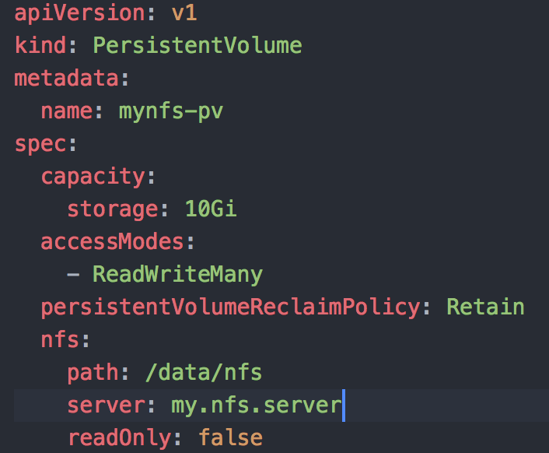
NFS Persistent Storage Architecture Easy to implement and versatile solution that can leverage existing NAS storage services within the enterprise
NFS PVs support the following access modes:
ReadWriteOnce - the volume can be mounted as read-write by a single node
ReadOnlyMany - the volume can be mounted read-only by many nodes
ReadWriteMany - the volume can be mounted as read-write by many nodes
Supports all reclamation policies
Does not natively support dynamic provioning**
Example workflow:
Create the NFS share and authorize access
Define your Persistent Volume
Make the Persistent Volume Claim
Access the Persistent Volume Claim from your pod(s)
**Dynamic provisioning may be supported in some implementations
Notes:
Portable Operating System Interface IEEE standard
Heterogeneous Commodity Hardware
Typical NAS has limited scalability
Network Attached Storage
POSIX-Compliant distributed file-system
Differentiator -> No central metadata server
Aggregator of storage and metadata
Flexible scaling for capacity and performance
NOTE: Red Hat Gluster Storage (formerly Red Hat Storage Server) is built upon the open source GlusterFS at gluster.org
and when they do they include metadata servers that tend to become a bottleneck
SAN obviously scales at a price

Slide 16
Storage via the vSphere Cloud Provider Provides integration with the vSphere Software Defined Storage platform that integrates with block, file and hyperConverged storage offerings
Storage provided via vSAN, VMFS and VVol datastores depending on the backend storage used
Supports dynamic provisioning, encryption and de-duplication
Full support of RWO however does not support RWX / ROX (unless pods are collacated to a single node
Notes:
Create 2 x node number so that every working node has a standby node in case the working node fails, allowing the backup node to host the vSAN pods as soon as possible.
WARNING: If a node with a vSphereVolume attached dies the vmdk must be manually unlocked from that VM prior to recycling or reuse. Practice this scenario in your environment.

Slide 17
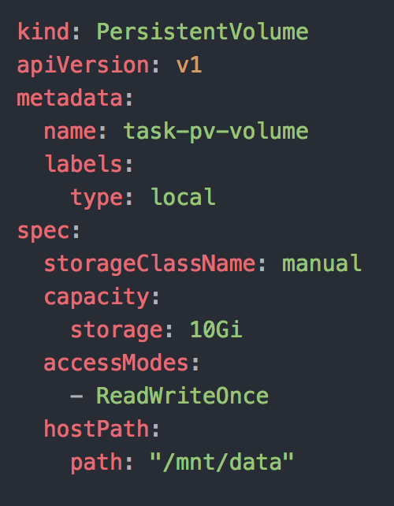
HostPath Storage Provider HostPath is a storage provider created for easer of development / testing and should not typically be considered for shared or production environments
Easy to configure and “get something working”
Data is not synced across multiple worker nodes thus can only persist if the pod is configured with affinity to a single node
Requires manual management
Not natively a secure method for managing storage

Slide 18
Making Storage Decisions
Finding the Best Solution for You

Slide 19
Which storage options are best?
Your solution likely lends itself to multiple storage options
Although you may find a single solution that fits the majority of your use cases, consider meeting outliers with a solution that isn’t the MOST convenient, but perhaps allows you to make a better choice for the majority case
Consider your access policy requirements
Analyze the workload and its requirements (RWO, RWX, ROX) and determine how often each access mode is required. Compare this with the storage solutions ability to make storage provisioning dynamically and consider the ramifications to your deployment workflow.
Don’t ignore the estate
Your operations team has storage solutions and preferences that may conflict with your instincts. They may or may not be willing to adopt yet-another-storage-solution. Don’t ignore the effort required to manage the solution as it moves to steady-state. You may be required to bring along the entire operations model for the solution including support, monitoring, security, compliance, disaster recover, backup etc..
IBM Cloud / © 2018 IBM Corporation
19

Slide 20
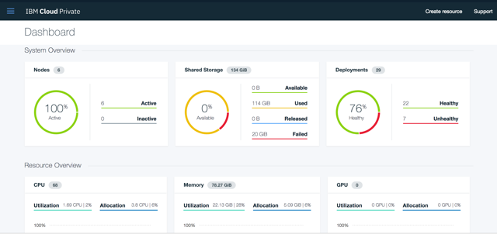
Try IBM Cloud Private today!
Guided and Proof of Technology demos
Free Community Edition!
http://ibm.biz/ICP-DTE
20
20
IBM Cloud / © 2018 IBM Corporation

Slide 21
21

